Slide 1
Fundamentals of Remote Sensing
“Eye on Sky”

Slide 2
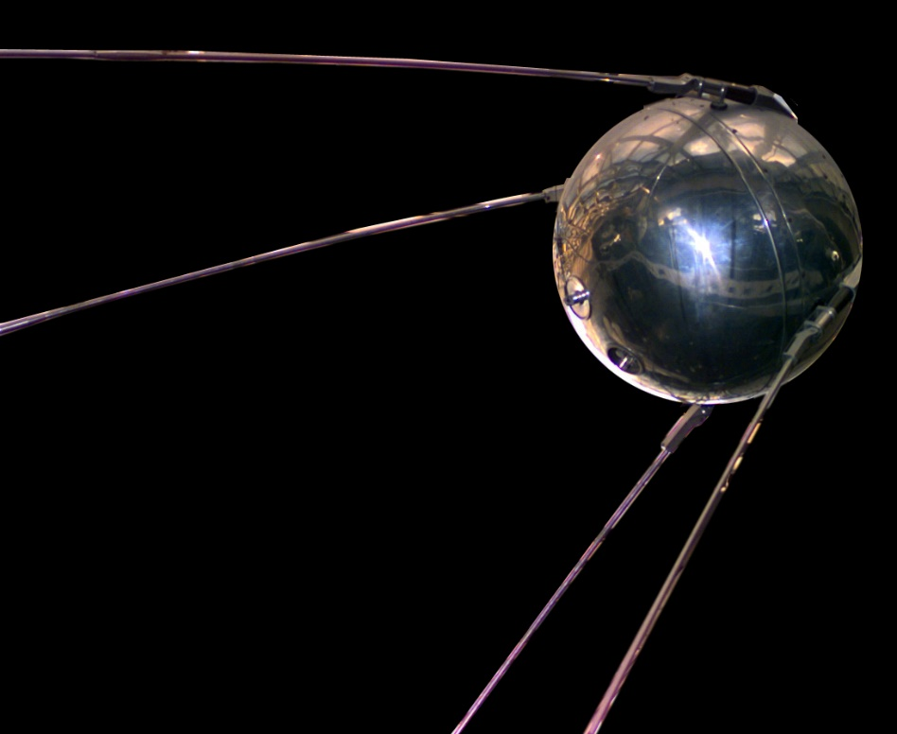
How many Satellites are there ?
Sputnik was the first satellite launched by Soviet Union on 4 October 1957

Slide 3
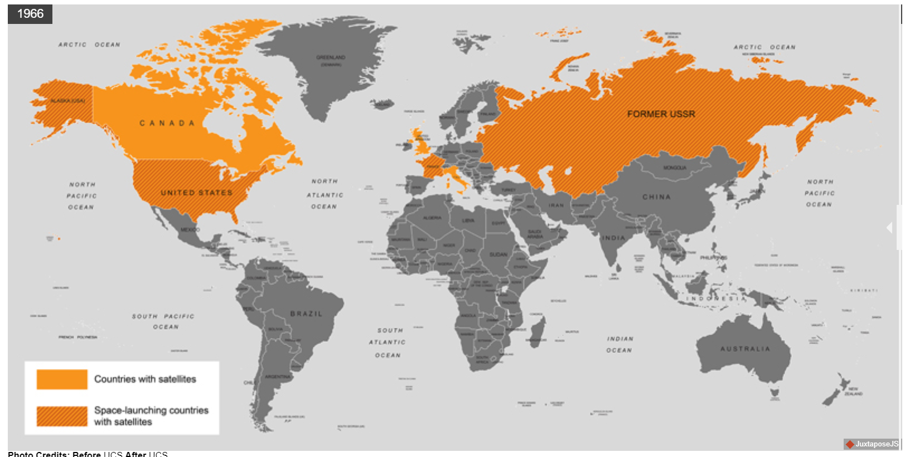
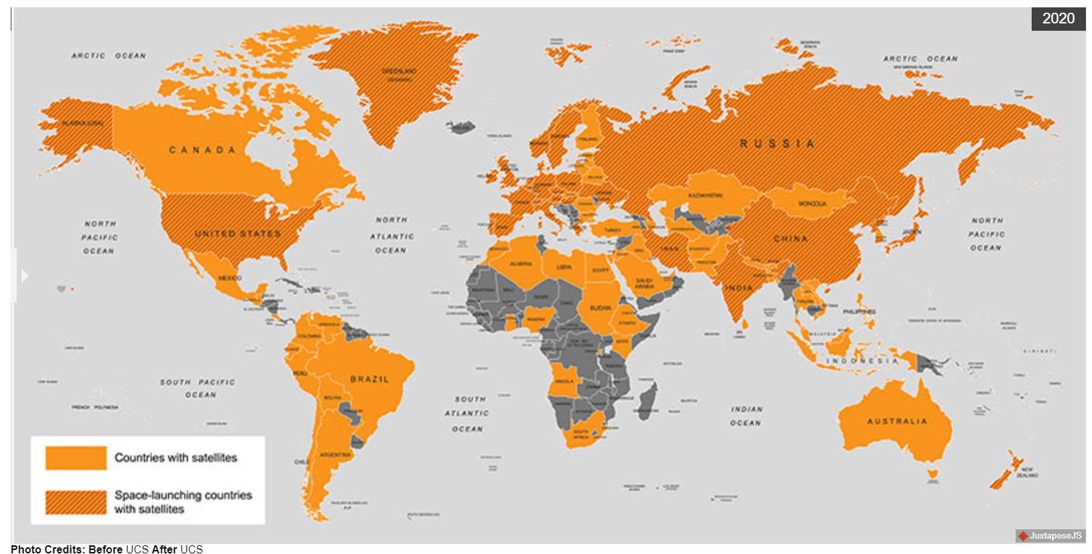
Countries with Satellites
1966
2020
https://www.ucsusa.org/resources/satellite-database

Slide 4
Countries with Satellites
1966
2020
https://www.ucsusa.org/resources/satellite-database

Slide 5
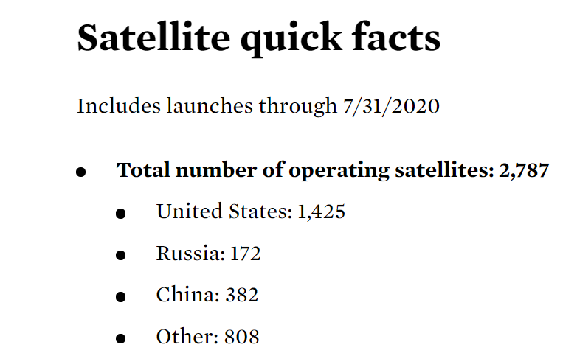
“The World is in love with Satellites”
Source : Union of Concerned Scientists – Satellite Database
A large percentage of these satellites are Earth Observation Satellites
https://www.ucsusa.org/resources/satellite-database

Slide 6
What is Remote sensing ?

Slide 7
What is Remote sensing ?
“Remote sensing is defined as the science and art of obtaining information about an object, area or phenomenon through the analysis of data acquired by device that is not in contact with the object, area or phenomenon under investigation”.
“The use of electromagnetic radiation sensors to record images of the environment, which can be interpreted to yield useful Information”. (Curran, 1985)

Slide 8
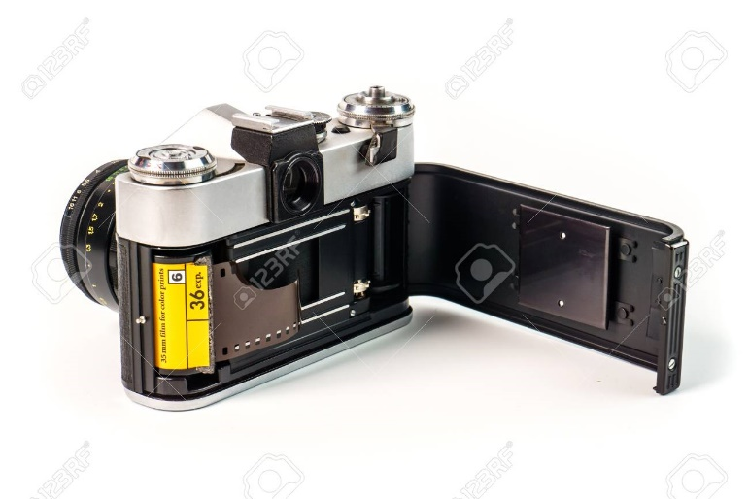

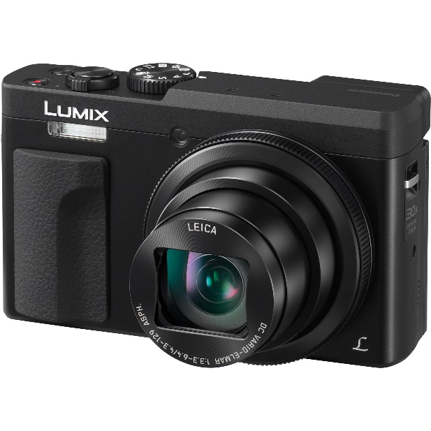
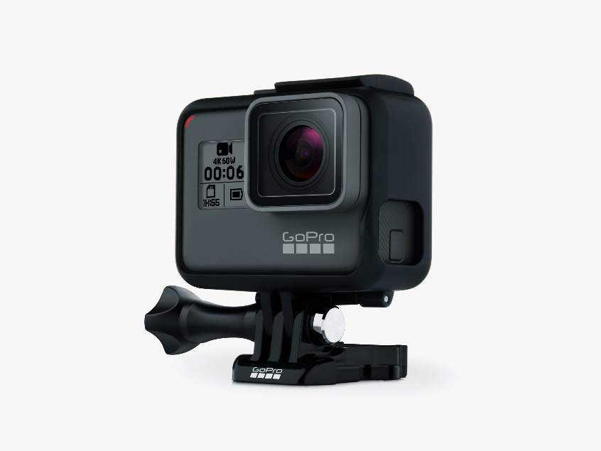
Everyday Remote Sensing Entities

Slide 9
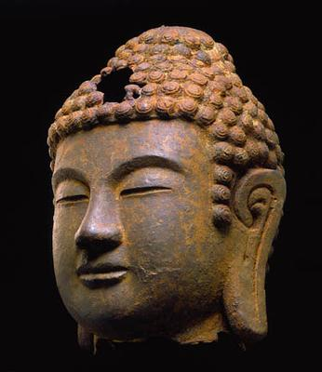
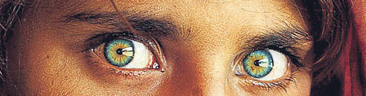
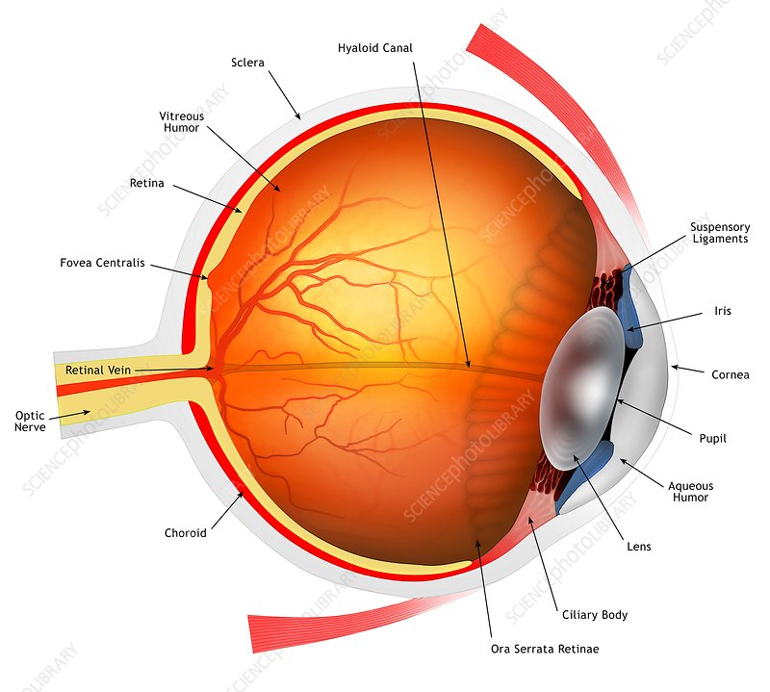
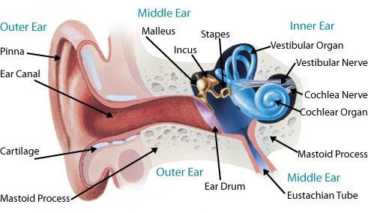
Everyday Remote Sensing Entities

Slide 10
Why Remote Sensing(RS)?
Provides an unique capability for data collection without the need to reach the site. This is specially useful for areas where accessibility is difficult.
RS provides a large coverage (eg: satellites cover a large area each day) and on a longer run is also cost effective.
It provides a capability to collect data from a larger area in short time.
Repetitive coverage provides data for change analysis geographic phenomena such as land cover, vegetation, weather, ice and snow cover, etc.

Slide 11
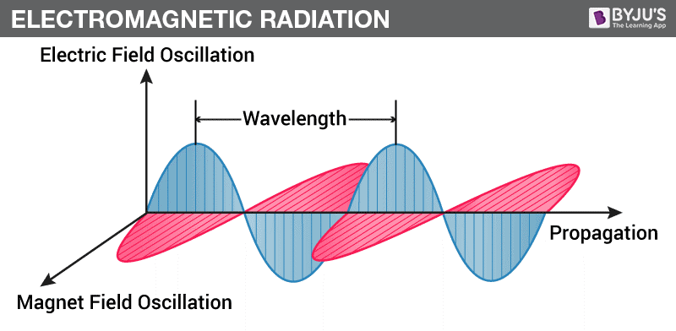
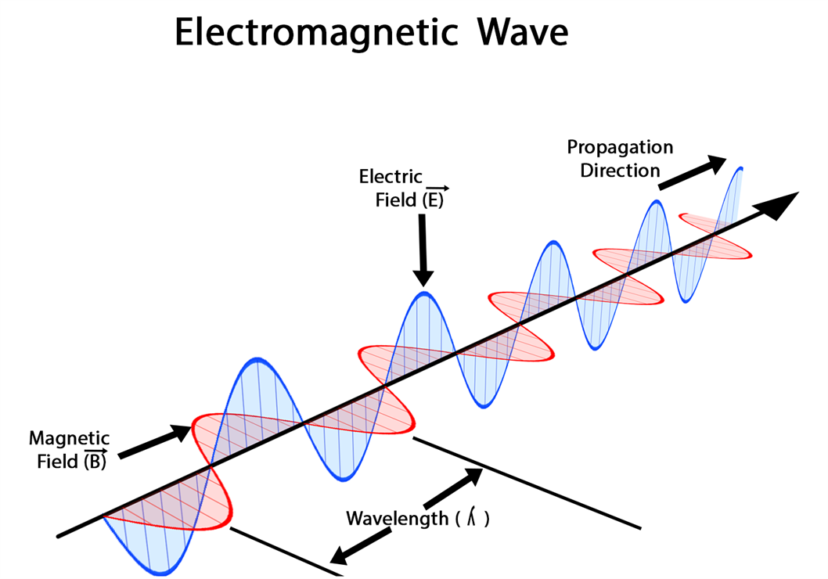
Electromagnetic Radiation
Electromagnetic radiation(from Sun or other active sources) is the basis of Remote Sensing.
Electromagnetic radiation are waves (sometimes also modelled as particles called photons).

Slide 12
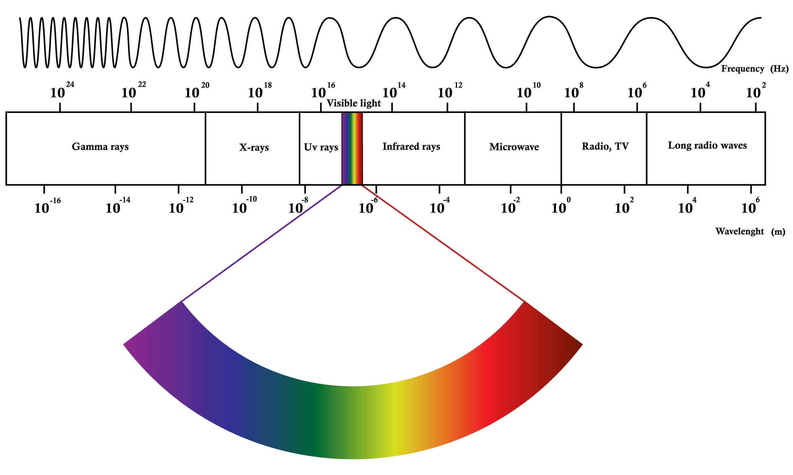
Electromagnetic Spectrum
The total range of wavelengths of Electromagnetic radiation is called Electromagnetic Spectrum.

Slide 13
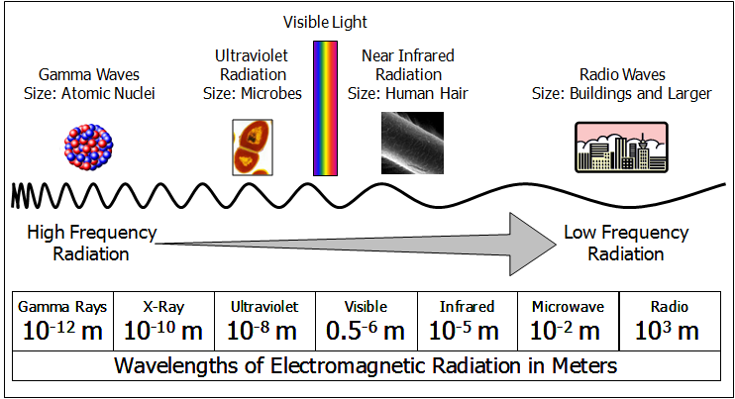
Electromagnetic Spectrum
The electromagnetic spectrum is generally divided into seven regions, in order of decreasing wavelength and increasing energy and frequency: radio waves, microwaves, infrared, visible light, ultraviolet, X-rays and gamma rays.

Slide 14
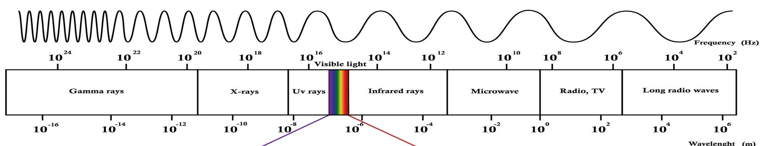
Radio waves
Radio waves are at the lowest range of the EM spectrum, with frequencies of up to about 30 billion hertz, or 30 gigahertz (GHz), and wavelengths greater than about 10 millimeters (0.4 inches). Radio is used primarily for communications including voice, data and entertainment media.
Microwaves
Microwaves fall in the range of the EM spectrum between radio and IR. They have frequencies from about 3 GHz up to about 30 trillion hertz, or 30 terahertz (THz), and wavelengths of about 10 mm (0.4 inches) to 100 micrometers (μm), or 0.004 inches. Microwaves are used for high-bandwidth communications, radar and as a heat source for microwave ovens and industrial applications.
Infrared
Visible Light
UltraViolet
X-ray
Gamma

Slide 15
Radio waves
Microwaves
Infrared
Infrared is in the range of the EM spectrum between microwaves and visible light. IR has frequencies from about 30 THz up to about 400 THz and wavelengths of about 100 μm (0.004 inches) to 740 nanometers (nm), or 0.00003 inches. IR light is invisible to human eyes, but we can feel it as heat if the intensity is sufficient.
Visible Light
Visible light is found in the middle of the EM spectrum, between IR and UV. It has frequencies of about 400 THz to 800 THz and wavelengths of about 740 nm (0.00003 inches) to 380 nm (.000015 inches). More generally, visible light is defined as the wavelengths that are visible to most human eyes.
UltraViolet
X-ray
Gamma

Slide 16
Radio waves
Microwaves
Infrared
Visible Light
UltraViolet
Ultraviolet light is in the range of the EM spectrum between visible light and X-rays. It has frequencies of about 8 × 1014 to 3 × 1016 Hz and wavelengths of about 380 nm (.000015 inches) to about 10 nm (0.0000004 inches). UV light is a component of sunlight; however, it is invisible to the human eye. It has numerous medical and industrial applications, but it can damage living tissue.
X-ray
X-rays are roughly classified into two types: soft X-rays and hard X-rays. Soft X-rays comprise the range of the EM spectrum between UV and gamma rays. Soft X-rays have frequencies of about 3 × 1016 to about 1018 Hz and wavelengths of about 10 nm (4 × 10−7 inches) to about 100 picometers (pm), or 4 × 10−8 inches. Hard X-rays occupy the same region of the EM spectrum as gamma rays. The only difference between them is their source: X-rays are produced by accelerating electrons, while gamma rays are produced by atomic nuclei.
Gamma

Slide 17
Radio waves
Microwaves
Infrared
Visible Light
UltraViolet
X-ray
Gamma
Gamma-rays are in the range of the spectrum above soft X-rays. Gamma-rays have frequencies greater than about 1018 Hz and wavelengths of less than 100 pm (4 × 10−9 inches). Gamma radiation causes damage to living tissue, which makes it useful for killing cancer cells when applied in carefully measured doses to small regions. Uncontrolled exposure, though, is extremely dangerous to humans.

Slide 18
Remote Sensing Process

Slide 19
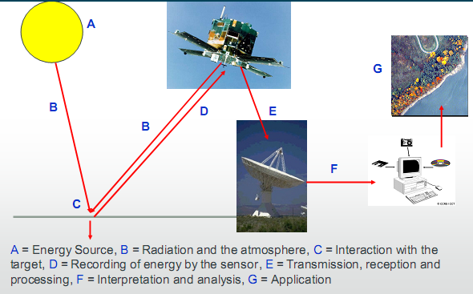
Remote Sensing Process
All satellite remote sensing systems involve the measurement of electromagnetic radiation.
1. Energy Source or Illumination (A)
2. Radiation and the Atmosphere (B)
3. Interaction with the Target (C)
4. Recording of Energy by the Sensor (D)
5. Transmission, Reception, and Processing (E)
6. Interpretation and Analysis (F)
7. Application (G)
Notes:
Remote sensing is all about the electomagnetic radiation emitted and sensed by source and sensors.
A EMR emitted from source interacts with atmosphere and then interacts with traget wihc is sensed by sensors to get the useul information
Remote sensing system thus have four components

Slide 20
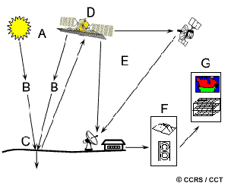
Remote Sensing Process
Energy Source or Illumination (A)
The first requirement for remote sensing is to have an energy source which illuminates or radiates electromagnetic energy to the target of interest.
Type of source
Natural radiation
Solar radiation
Terrestrial radiation
Artificial radiation
Radar
Laser Scanner
Passive sources uses Natural source of radiation.
Active sources emit their own radiation.

Slide 21
Passive Sensors
Passive sensors record radiation reflected from the earth´s surface and the source of this radiation must come from outside the sensor – in most cases this is solar energy. Normally, passive sensors only capture data during daylight hours.
Film-based and digital cameras, both aerial and handheld, as well as digital satellite sensors, such as Landsat Thematic Mapper, are examples of passive sensors.

Slide 22
Active sensors
Active sensors pulse energy at a target and measure the return, or reflection.
Light Detection and Ranging (LiDAR) and Radio Detection and Ranging (RADAR) are two examples of active sensors. A laser-beam remote sensing system is an active sensor that sends out a beam of light with a known wavelength and frequency. This beam of light hits the earth and is reflected back to the sensor, which records the time it took for the beam of light to return.

Slide 23
Student Task : Summarize the advantages and disadvantages of Passive and Active remote sensing.

Slide 24
Remote Sensing Platforms
Satellites
Planes
Helicopters
Unmanned Aerial Vehicles
Terrestrial

Slide 25
Remote Sensing Process
2. Radiation and the Atmosphere (B)
As the energy travels from its source to the target, it will come in contact with and interact with the atmosphere as it passes through. This interaction may take place a second time as the energy travels from the target to the sensor.

Slide 26
Energy interaction in Atmosphere
2. Radiation and the Atmosphere (B)
Before radiation used for remote sensing reaches the Earth's surface it has to travel through some distance of the Earth's atmosphere.
Particles and gases in the atmosphere can affect the incoming light and radiation. These effects are caused by the mechanisms of Scattering , Absorption and Transmission.

Slide 27
Scattering
2. Radiation and the Atmosphere (B)
Scattering occurs when particles or large gas molecules present in the atmosphere interact with and cause the electromagnetic radiation to be redirected from its original path.
How much scattering takes place depends on several factors including the wavelength of the radiation, the abundance of particles or gases, and the distance the radiation travels through the atmosphere.
There are three (3) types of scattering which take place.
Rayleigh Scattering
Mie Scattering
Non Selective Scattering

Slide 28
Scattering : Rayleigh Scattering
2. Radiation and the Atmosphere (B)
Rayleigh scattering occurs when particles are very small compared to the wavelength of the radiation.
These could be particles such as small specks of dust or nitrogen and oxygen molecules.
Rayleigh scattering causes shorter wavelengths of energy to be scattered much more than longer wave lengths.
The fact that the sky appears "blue" during the day and reddish during sunset or sunrise is because of this phenomenon.

Slide 29
Scattering : Mie Scattering
2. Radiation and the Atmosphere (B)
Mie scattering occurs when the particles are just about the same size as the wavelength of the radiation.
Dust, smoke and water vapors are common causes of Mie scattering which tends to affect longer wavelengths than those affected by Rayleigh scattering.
Mie scattering occurs mostly in the lower portions of the atmosphere where larger particles are more abundant.

Slide 30
Scattering : Non Selective Scattering
2. Radiation and the Atmosphere (B)
Nonselective scattering occurs when the particles are much larger than the wavelength of the radiation.
Water droplets and large dust particles can cause this type of scattering.
Nonselective scattering gets its name from the fact that all wavelengths are scattered about equally.
This type of scattering causes fog and clouds to appear white to our eyes because blue, green, and red light are all scattered in approximately equal quantities (blue+green+red light = white light).

Slide 31
Absorption
2. Radiation and the Atmosphere (B)
Absorption is the other main mechanism at work when electromagnetic radiation interacts with the atmosphere.
In contrast to scattering, this phenomenon causes molecules in the atmosphere to absorb energy at various wavelengths.
Ozone, carbon dioxide, and water vapor are the three main atmospheric constituents which absorb radiation.

Slide 32
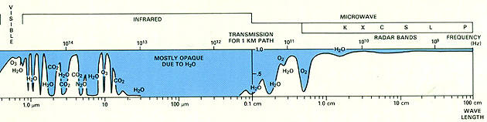
Atmospheric window
2. Radiation and the Atmosphere (B)
Those areas of the spectrum which are not severely influenced by atmospheric absorption and thus, are useful to remote sensors, are called atmospheric windows.
Regions in electromagnetic spectrum were absorption is low:
Visible window: 0.4-0.9µm
Near infrared window: 1.5-1.75µm, 2-2.4µm
Far infrared window: 3-5µm, 8-14µm

Slide 33
Transmission
2. Radiation and the Atmosphere (B)
Transmission is that process in the atmosphere in which the energy besides absorbed and scattered are transmitted through the atmosphere and reach to the earth surface. Atmospheric window allows energy to be transmitted.

Slide 34
3. Interaction with the Target (C)
Once the energy makes its way to the target through the atmosphere, it interacts with the target depending on the properties of both the target and the radiation.

Slide 35
Energy interaction with earth surface
3. Interaction with the Target (C)
Radiation that is not absorbed or scattered in the atmosphere can reach and interact with the Earth's surface. There are three (3) forms of interaction that can take place when energy strikes, or is incident (I) upon the surface.
These are: absorption (A); transmission (T); and reflection (R). The total incident energy will interact with the surface in one or more of these three ways. The proportions of each will depend on the wavelength of the energy and the material and condition of the feature.

Slide 36
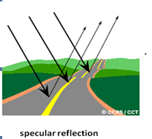
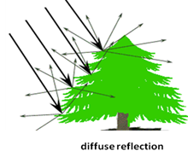
Reflection
3. Interaction with the Target (C)
Reflection (R) occurs when radiation "bounces" off the target and is redirected.
In remote sensing, we are most interested in measuring the radiation reflected from targets.
We refer to two types of reflection, which represent the two extreme ends of the way in which energy is reflected from a target: specular reflection and diffuse reflection.
When a surface is smooth we get specular or mirror-like reflection where all (or almost all) of the energy is directed away from the surface in a single direction.
Diffuse reflection occurs when the surface is rough and the energy is reflected almost uniformly in all directions .

Slide 37
Spectral reflectancy
3. Interaction with the Target (C)
Spectral reflectancy is unique property of any object for reflection, absorption and transmission which produce a unique spectral signature of reflectance for any object in different wavelength region. It is due to difference in spectral characteristics of objects.
Reflectance measurement can be carried out in a lab(spectral libraries) or in a field using spectrometer.

Slide 38
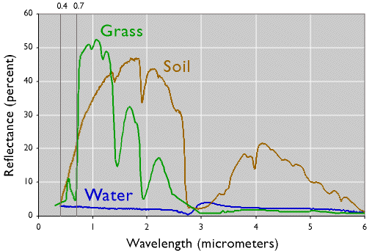
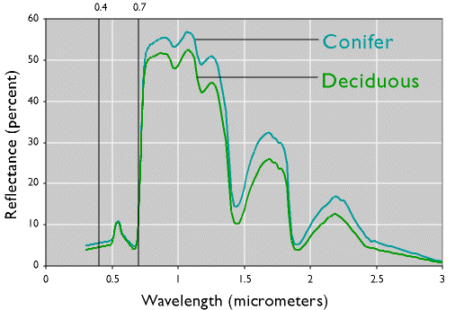
Spectral Reflectance Curve
3. Interaction with the Target (C)
The reflectance with respect to the wavelength is called spectral reflectance Spectral reflectance curve shows a portion of incident energy that is reflected as a function of wave length.
Different materials shows different spectral signature because of their unique properties.
The magnitude of energy that an object reflects or emits across a range of wavelengths is called its spectral response pattern.

Slide 39
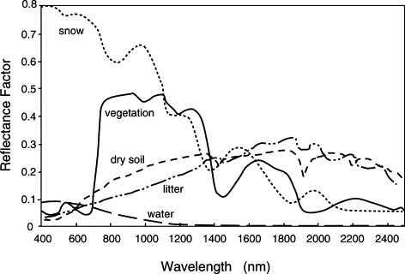
Spectral reflectance curve of different materials
3. Interaction with the Target (C)

Slide 40
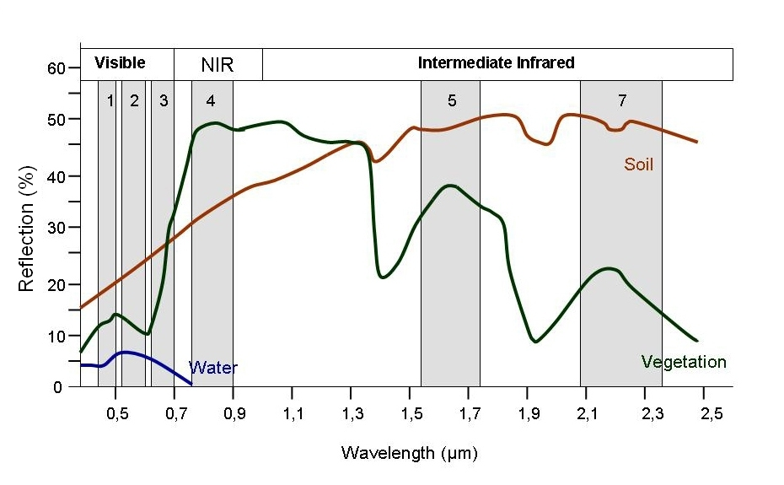
How to distinguish water and vegetation ?

Slide 41
Remote Sensing Process
4. Recording of Energy by the Sensor (D)
After the energy has been scattered by, or emitted from the target, we require a sensor (remote - not in contact with the target) to collect and record the electromagnetic radiation.

Slide 42
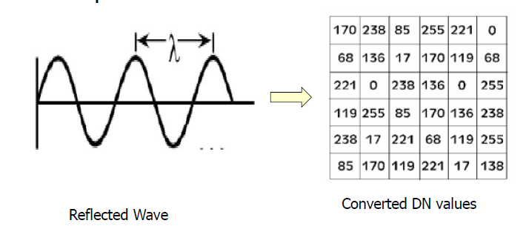
Conversion of the reflected energy into data
4. Recording of Energy by the Sensor (D)
Incoming reflected electromagnetic wave is converted to a Digital Number (DN) for each pixel for each band.

Slide 43
Remote Sensing Process
5. Transmission, Reception, and Processing (E) - the energy recorded by the sensor has to be transmitted, often in electronic form, to a receiving and processing station where the data are processed into an image (hardcopy and/or digital).
6. Interpretation and Analysis (F) - the processed image is interpreted, visually and/or digitally or electronically, to extract information about the target which was illuminated.

Slide 44
Remote Sensing Process
7. Application (G) - the final element of the remote sensing process is achieved when we apply the information we have been able to extract from the imagery about the target in order to better understand it, reveal some new information, or assist in solving a particular problem.

Slide 45
Resolution of Satellite Images(Data)

Slide 46
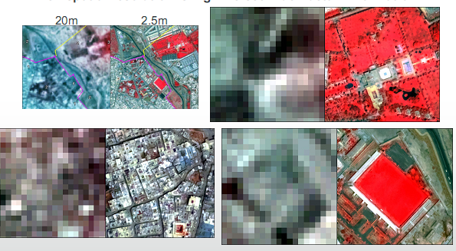
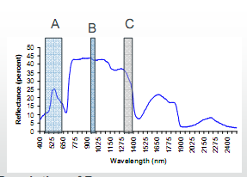
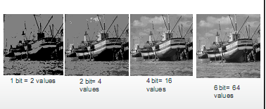
Resolution
“The ability of an imaging system to record fine details in a distinguishable manner” (Estes and Simonett, 1975)
This can be
Spatial ( objects in ground)
Spectral ( portion of EMR)
Radiometric ( level of signal)
Temporal (Sensor Visit)

Slide 47
Resolution
“Resolution” in Remote Sensing refers to the ability of a sensor to distinguish or resolve objects that are physically near or spectrally similar to other adjacent objects.
Spatial Resolution
Spectral Resolution
Radiometric Resolution
Temporal Resolution
Notes:
Image resolution is the detail an image holds.

Slide 48
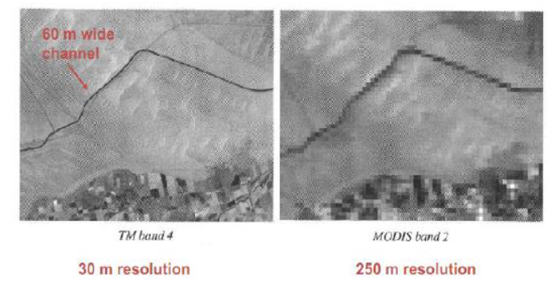
Spatial Resolution
Refers to the size of the smallest possible feature that can be detected in image
An increase in spatial resolution corresponds to an increase in the ability to resolve one feature physically from another.
Controlled by power of sensor system, depends upon sensor altitude, detector size, etc.
Notes:
Spatial resolution depends upon the IFOV (the angular cone of visibility of the sensor) and determines the area on the earth’s surface which is seen from a given altitude or at a particular moment of time. If a sensor has a spatial resolution of 20 metres and an image from that sensor is displayed at full resolution, each pixel represents an area of 20m x 20m on the ground. In this case the pixel size and resolution are the same.
Map Scale= raster resolution (in meters)*2*1000

Slide 49
Spectral Resolution
It describes the ability of the sensor to define wavelength intervals.
The finer the spectral resolution, the narrower the wavelength range for a particular channel or band.
Spectral resolution refers to the width of spectral bands.
Notes:
Broad classes, such as water and vegetation, can usually be separated using very broad wavelength ranges - the visible and near infrared. Other more specific classes, such as different rock types, may not be easily distinguishable using either of these broad wavelength ranges and would require comparison at much finer wavelength ranges to separate them. Thus, we would require a sensor with higher spectral resolution.

Slide 50
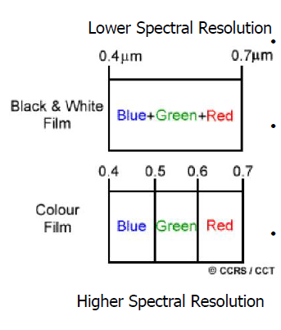
Spectral Resolution
Black and white films record wavelength extending over the visible portion of the electromagnetic spectrum.
Wavelengths are not individually distinguished and the overall reflectance in the entire visible portion is recorded.
Colour film is individually sensitive to the reflected energy at the blue, green and red wavelengths of the spectrum.

Slide 51
Radiometric Resolution
Radiometric resolution is the detector’s ability to distinguish differences in the strength of emitted or reflected electromagnetic resolution.
Radiometric resolution is determined by the number of digital levels that a sensor can use to express variability of brightness within the data.
Notes:
Every time an image is acquired on film or by a sensor, its sensitivity to the magnitude of the electromagnetic energy determines the radiometric resolution. The radiometric resolution of an imaging system describes its ability to discriminate very slight differences in energy The finer the radiometric resolution of a sensor, the more sensitive it is to detecting small differences in reflected or emitted energy.

Slide 52
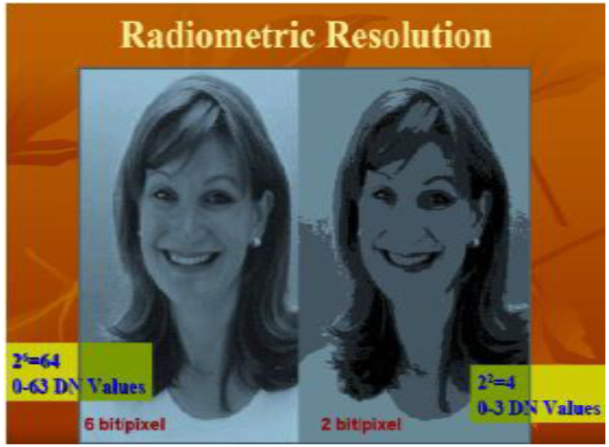

Slide 53
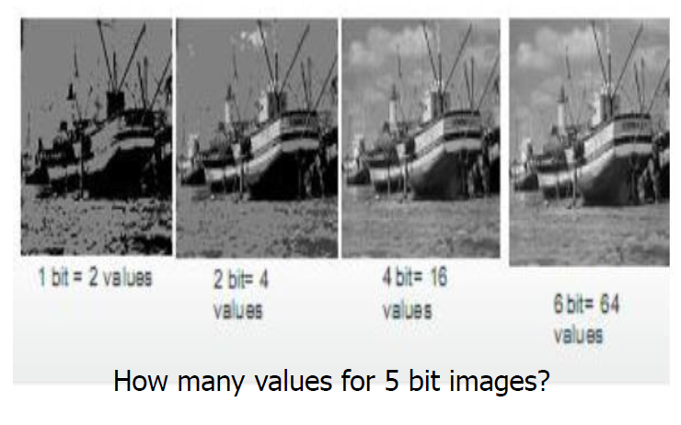

Slide 54
Temporal Resolution
Minimum time between two images of the same area.
Related to the repetitive coverage of the ground by the remote sensing system.
The temporal resolution of Landsat 4/5 is sixteen days.
Muti-temporal images are important for the study of:
Frequent observational opportunities (eg. When clouds obscure the surface)
Short-lived phenomenon (floods, oil spills, etc.)
Rapid response (fires, hurricanes, etc.)

Slide 55
Image Interpretation

Slide 56
Image Interpretation
Extract meaningful information from images.
Interpretation and analysis of remote sensing imagery involves the identification and/or measurement of various targets in an image in order to extract useful information about them.
Targets may be a point, line, or area feature.

Slide 57
Visual Image Interpretation
Most intuitive way to extract information the image from remote sensing images.
Based on human’s ability to relate colors and patterns in the image to the real world features.

Slide 58
Visual Image Interpretation
Spontaneous recognition
Identification at first glance
Logical inference
Converging evidences (clues come together)
Associative thinking (A therefore B)
External Information
Addition data by fieldwork

Slide 59
Interpretation elements
(Grey) Tone
Hue
Shape
Size
Shadow
Pattern
Texture
Location/ Site
Association
Tone
Relative brightness of black/white images
Hue
Color in image
Shape
Helps to determine the character of the object (build up aras, roads, railroads, agricultural fields)
Size: width of roads can be estimated from the size of cars thus roads can be primary or secondary.
Pattern: spatial arrangement of objects and implies the characteristic repetition of certain forms or relationships.
Texture: roughness of the surface.
Site: Geographical location.

Slide 60
Interpretation elements
Association: combination of objects. A ground (open space) behind a building are more likely to be school and playground.
Shadow: Trees, buildings, animals, bridges and towers are examples of features that cast distinctive shadows. Building cast definitive shadows. Can be used to distinguish buildings from pavements.

Slide 61
Remote Sensing Systems (Satellites and Sensors)

Slide 62
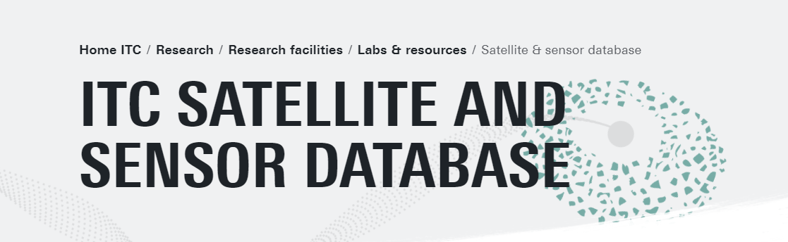
A database of ITC (University of Twente provides one of the most comprehensive list of satellite and sensors
https://www.itc.nl/research/research-facilities/labs-resources/satellite-sensor-database/

Slide 63
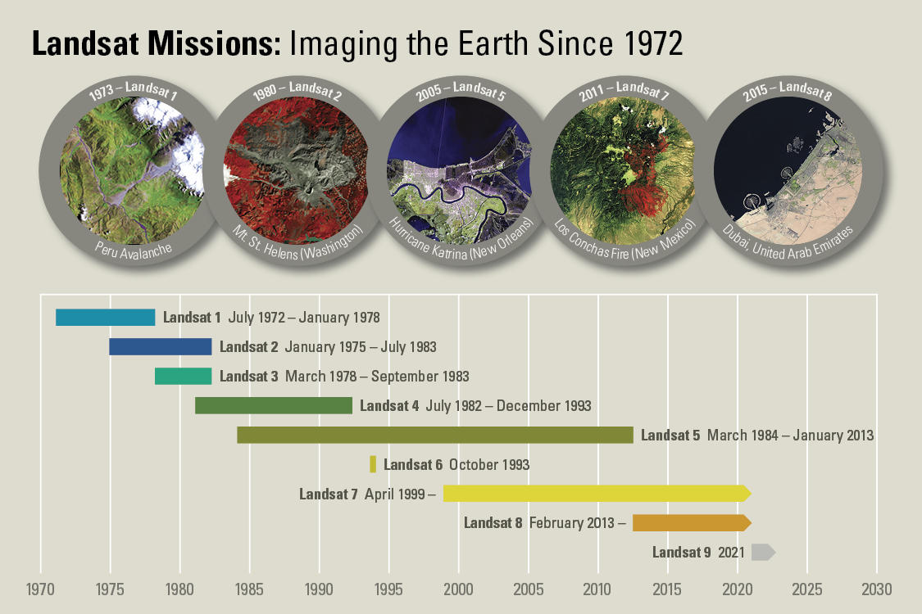
Landsat Program
Longest Running Program for Satellite Imagery Acquisition

Slide 64
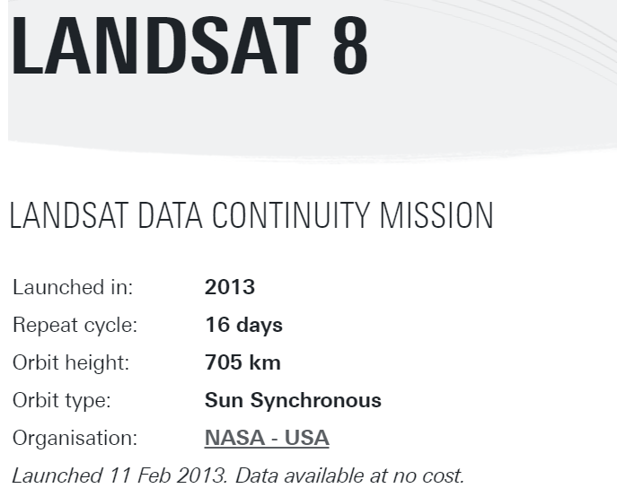
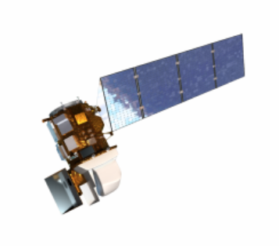

Slide 65
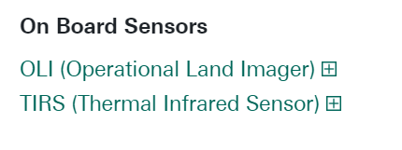

Slide 66
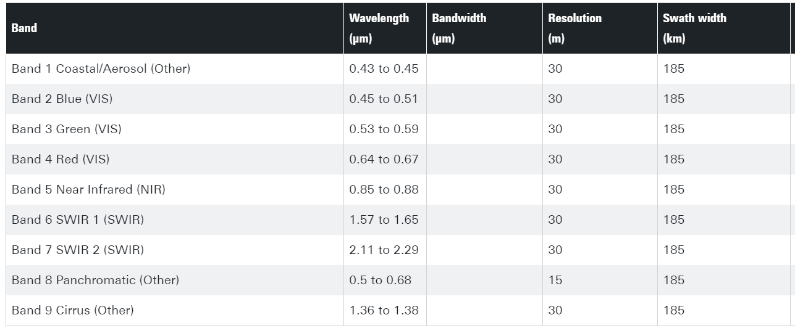

Slide 67
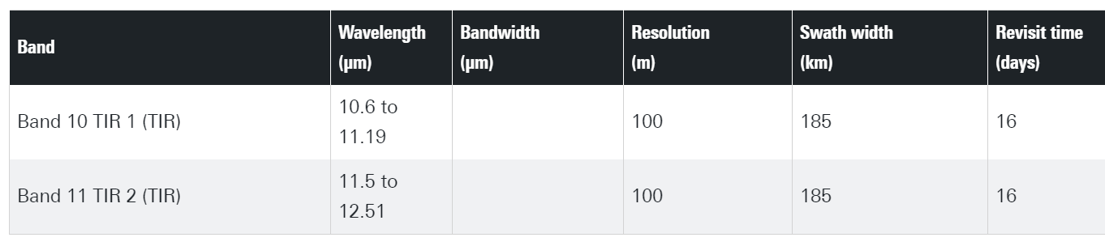

Slide 68
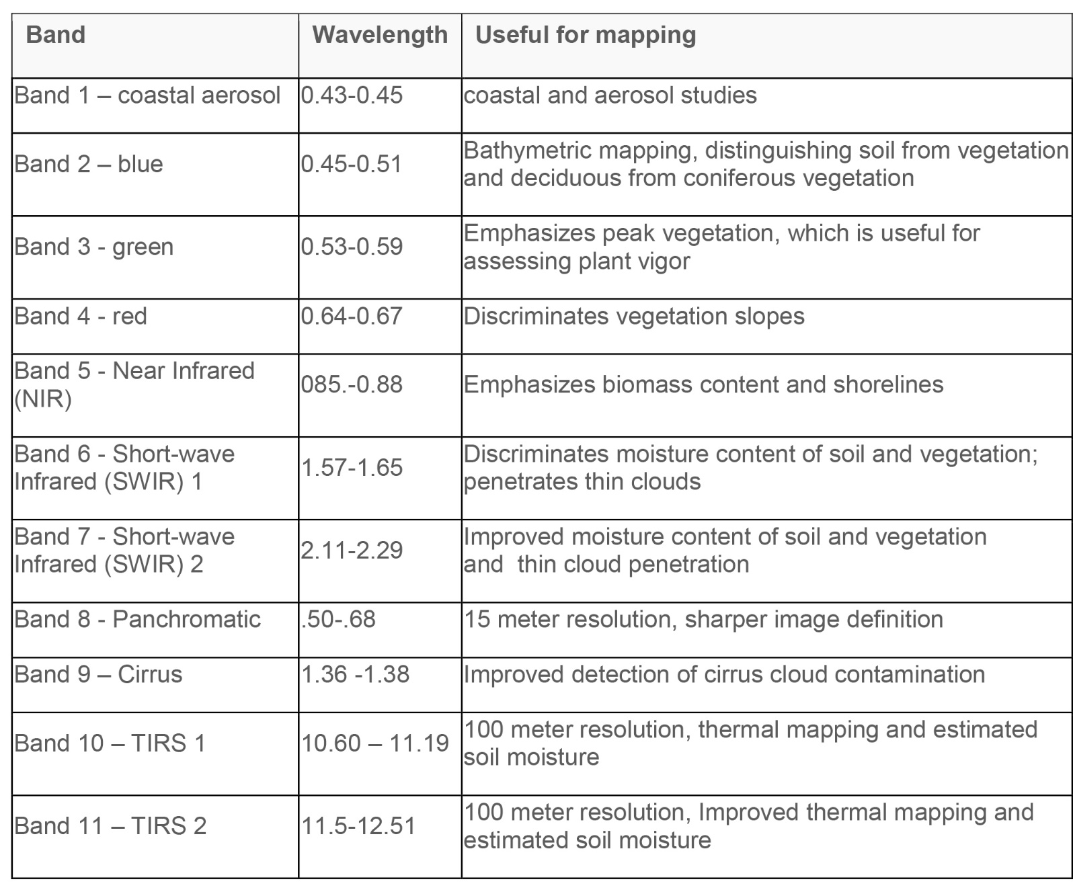

Slide 69
Major Remote Sensing Systems
Meteosat
NOAA
Landsat
Terra
SPOT
Satellites of IRS
Ikonos
EO-1
Proba/CHRIS
Envisat

Slide 70
Case Study
Prepare a summary report and a presentation of one major remote sensing systems that have application in the area of land and water resources. Ensure there is no duplication with you class.
We will conduct a presentation session, provided we can spare time.

Slide 71
End of Session

